Slide 1
Movie Box Office Prediction
ISYE 6414 - Regression Analysis
Alex Yang, Dheerachote Korpajarasoontorn, Maxime Alos

Slide 2
Agenda
Introduction and Problem definition
Data
Dataset presentation
Data cleaning and feature engineering
Exploratory data analysis
Modeling
Simple regression
BoxCox transformation + Regression
Lasso regression
Weighted Least Squares
Results & conclusion

Slide 3

Introduction and Problem Definition
Movie industry worth:
$32 billion in 2020
How to estimate the success of a movie idea?
We propose to predict a movie’s box office (its revenue) using different models.

Slide 4
Data
First dataset extracted from TMDB and found on Kaggle
7938 entries for movies
22 features including quantitative and descriptive information such as:
Budget
Popularity
Length of the movie
Cast and crew information
Original language
Languages the movie has been translated into
Revenue (prediction goal)
Second dataset containing information about director revenue.
Merged the 2 datasets on director name to obtain final dataset.

Slide 5
Data Cleaning and Feature Engineering
Missing Data: Dropping rows and cols with null values (<1% of dataset)
Text Information, Feature Engineering:
Binary Variable for English Language and Collection of Movies
Famous movie director represented by their total box office
Skewed Data: box-cox transformation

Slide 6
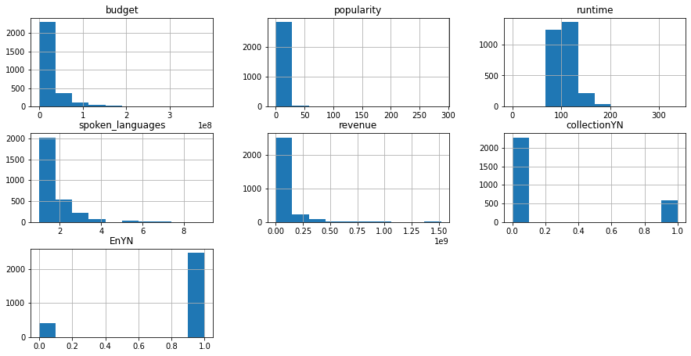
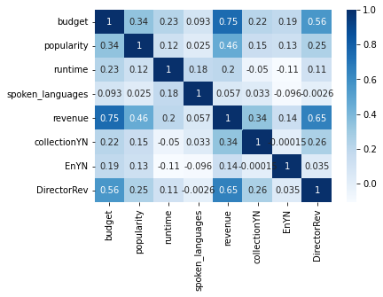
Exploratory Data Analysis
Notes:
We performed the exploratory data analysis to investigate the correlation between the fitting parameters. From here, we found that the budget, popularity and director’s influence played an important role in the movie box office. This validated the idea that we had to choose this given parameters. Again, in these plots, we observed that the scewness of some col data may be high and we would later perform the box-cox transformation.

Slide 7
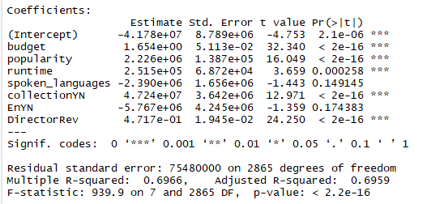
Simple Linear Regression Model
X = df[['budget',"popularity", "runtime", "spoken_languages", "collectionYN", "EnYN", "DirectorRev"]]
y = df['revenue']
Notes:
We started the modeling with a simple linear regression (ordinary least square method). We decide to choose the following seven parameters for modeling: budget, popularity, runtime, spoken_languages, collection binary, English binary and Director’s revenue.
From the model output, we observed R squared value is ~70%, and also the P value is very small in this case, which indicating that model is acceptable.

Slide 8
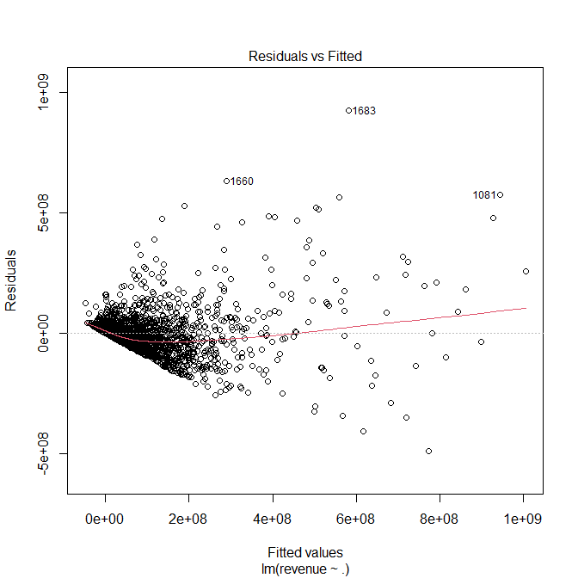
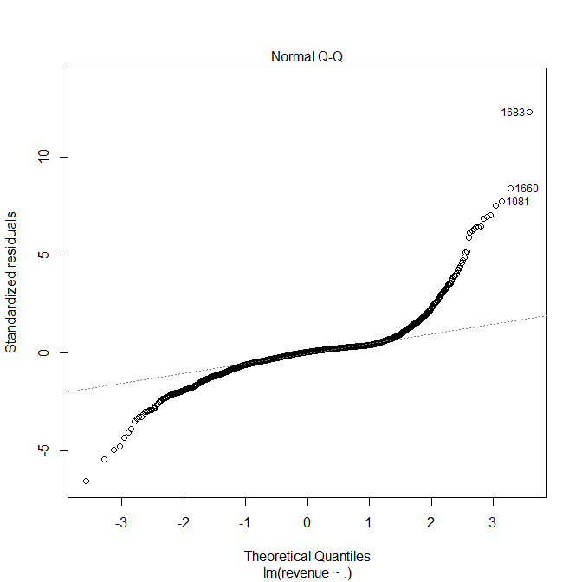
Simple Linear Regression Model
Notes:
The residuals from this model is diverging or heteroscedastic. The QQ plot is not perfectly shaped. Together of these two plots, we are informed that our data may not be normally distributed.

Slide 9
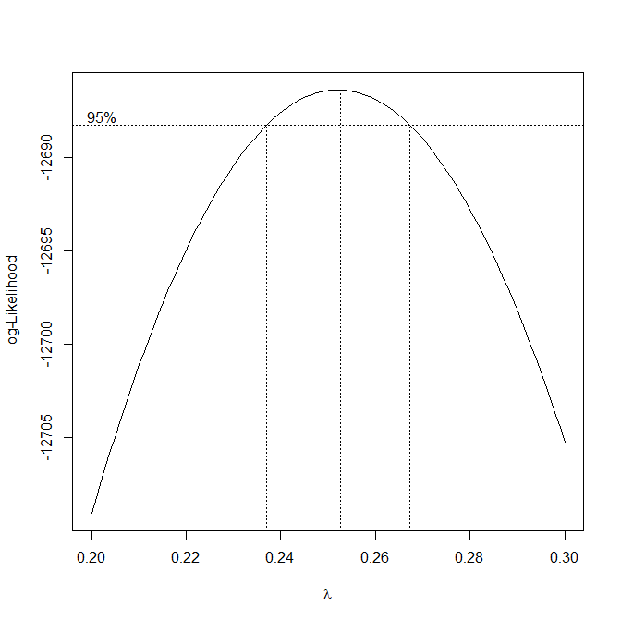
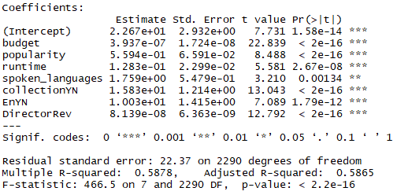
Box-Cox Transformation
Lambda ~ 0.25
Notes:
As we run the box-cox transformation, we obtained this plot as an output, and from the plot we found that lambda is about 0.25. With this information, we transform the dataset and run the linear regression model again. From the result we obtained that the R squared value is slightly lower than the first model. But does it mean that we got a worse model? It is hard to tell now.

Slide 10
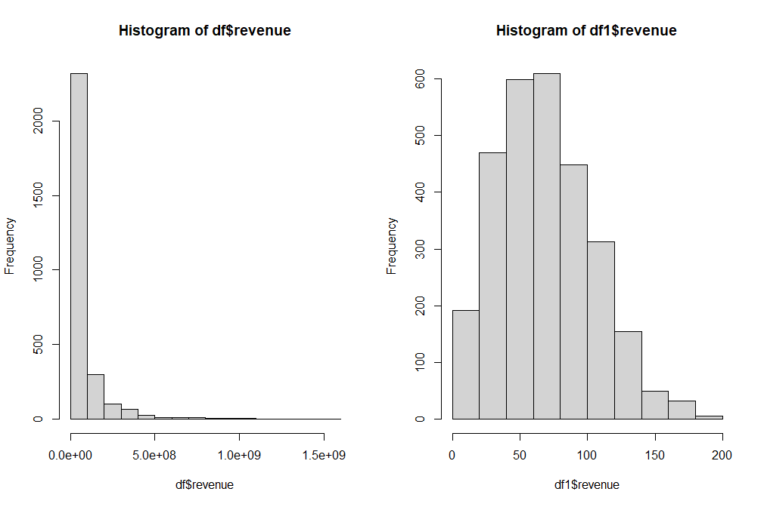
Distribution after Transformation
Notes:
We took a look at the transformed data and we found that the

Slide 11
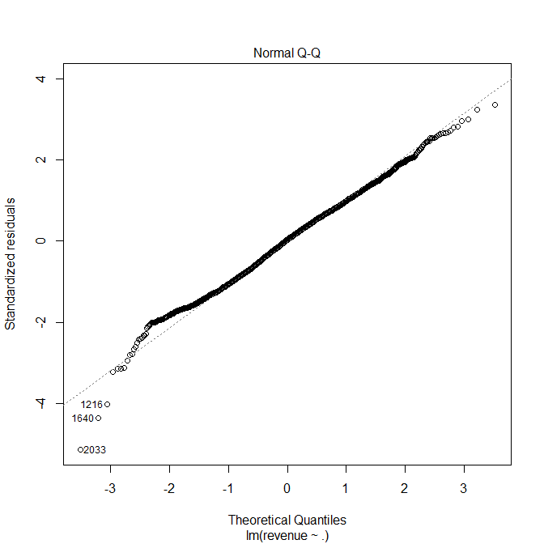
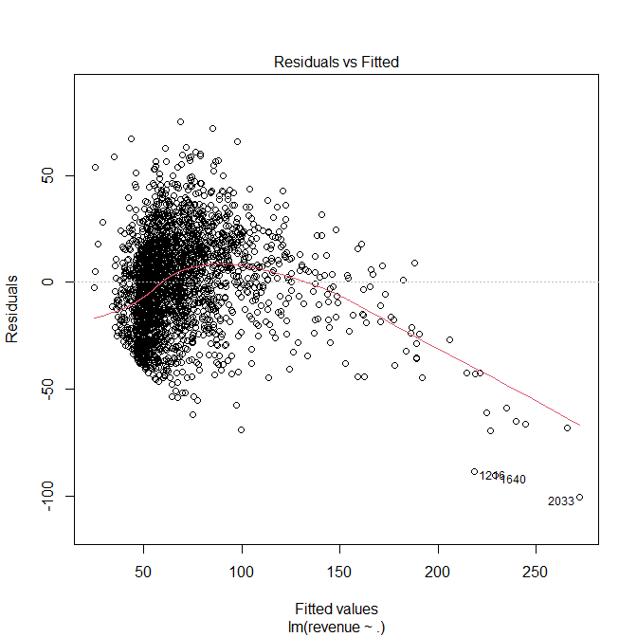
Regression with Box Cox Transformation
Notes:
After box-cox transformation, the residual converges and the qq plot is aligned with 45 degrees as expected. This also indicated that the box-cox transformation is improving the regression modeling in another aspect for this data set.

Slide 12
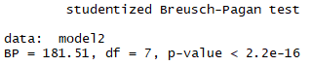
Breusch-Pagen test

Slide 13
Model Summary
Model | Test set R^2 | Test set Accuracy
Linear Regression (OLS) | 0.6966 | explained_variance: 0.6466 MAE: 42999738.1711 MSE: 5074247505192475.0 RMSE: 71233752.5699
Lasso Regression | 0.6966 (alpha = 1) 0.6242 (alpha = 10) | explained_variance: 0.6466 MAE: 42999734.1697 MSE: 5074247340139100.0 RMSE: 71233751.4114
Weighted Least Square (WLS) | 0.6462
Box-Cox Transformation + OLS | 0.5784 | explained_variance: 0.48 MAE: 48591414.51 MSE: 7317575598594847 RMSE: 85597829.435

Slide 14

Prediction for 007 (2021)

Slide 15
Prediction for 007 (2021)
Budget = $250 million
Popularity = 6
RunTime = 163 minutes
SpokenLanguage= 17
CollectionYN = 1
EnglishYN = 1
DirectorRevenue = $561 million

Slide 16
Prediction for 007 (2021)
Predicted Revenue = 691,483,170
True Revenue = 734,563,795 As of Nov 25
Accuracy on This Movie = 94%

